Slide 1
Greedy Algorithms

Slide 2
Concept
Greedy algorithms are also used solve optimization problems.
Greedy approach suggests constructing a solution through a sequence of steps, each expanding a partially constructed solution obtained so far, until a complete solution to the problem is reached.

Slide 3
Concept…
On each step –and this is central point of this technique-the choice made must be
-feasible, i.e., it has to satisfy the problem’s constraints
Locally optimal, i.e., it has to be the best local choice among all feasible choices available on that step
Irrevocable, i.e., once made, it cannot be changed on subsequent steps of the algorithm

Slide 4
Greedy Approach Vs Dynamic programming
Greedy Approach works in top down manner while Dynamic programming works in bottom up manner
Greedy Approach makes a choice first then evaluate it while Dynamic programming evaluate all options then make choice.
Greedy Approach does not provide guarantee for optimal solution while Dynamic programming does.

Slide 5
An Activity Selection Problem
This is the problem of scheduling several competing activities that require exclusive use of a common resource, with a goal of selecting a maximum-size set of mutually compatible activities.
Suppose we have a set S = {a1, a2, . . . , an} of n proposed activities that wish to use a resource, such as a lecture hall, which can be used by only one activity at a time.
Each activity ai has a start time si and a finish time fi, where 0 ≤ si < fi < ∞.

Slide 6
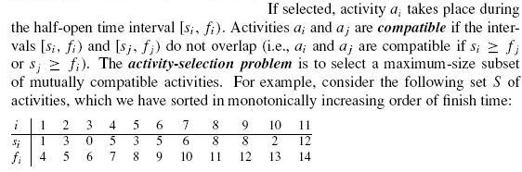
An Activity Selection Problem

Slide 7

An Activity Selection Problem…

Slide 8
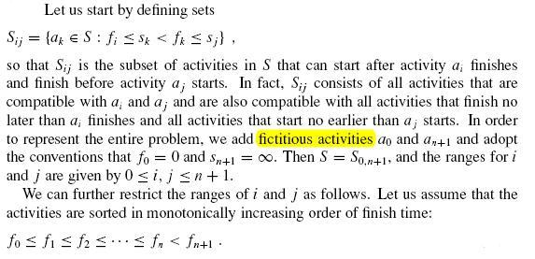
The optimal substructure of the activity-selection problem

Slide 9


The optimal substructure of the activity-selection problem…

Slide 10
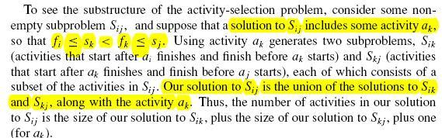
The optimal substructure of the activity-selection problem…

Slide 11

The optimal substructure of the activity-selection problem…

Slide 12
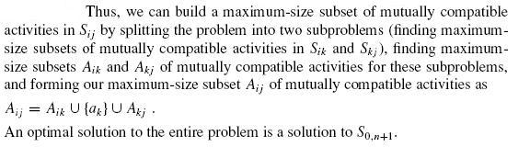
The optimal substructure of the activity-selection problem…

Slide 13
A recursive solution
Let c[i, j ] be the number of activities in a maximum-size subset of mutually compatible activities in Si j. We have c[i, j ] = 0 whenever Si j = ∅; in particular, c[i, j ] = 0 for i ≥ j.
if ak is used in a maximum- size subset of mutually compatible activities of Si j, we have recurrence.
c[i, j ] = c[i, k] + c[k, j ] + 1 .

Slide 14
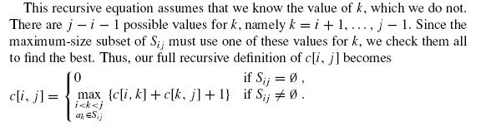
A recursive solution…

Slide 15
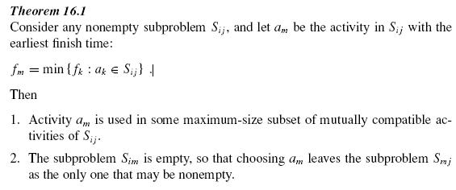
Converting a dynamic-programming solution to a greedy solution

Slide 16
A recursive greedy algorithm
We assume that the n input activities are ordered by monotonically increasing finish time, according to equation.
If not, we can sort them into this order in O(n lg n) time, breaking ties arbitrarily.
The initial call is RECURSIVE-ACTIVITY-SELECTOR(s, f, 0, n).

Slide 17
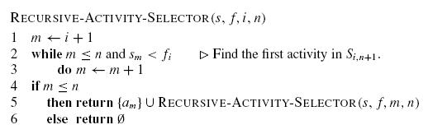
Recursive Greedy Algorithm
Example

Slide 18
An iterative greedy algorithm
The procedure GREEDY-ACTIVITY-SELECTOR is an iterative version of the procedure RECURSIVE-ACTIVITY-SELECTOR.
It also assumes that the input activities are ordered by monotonically increasing finish time. It collects selected activities into a set A and returns this set when it is done.

Slide 19
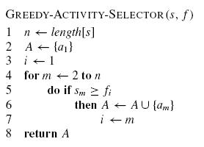

Slide 20
Greedy versus dynamic programming
Because the optimal-substructure property is exploited by both the greedy and dynamic-programming strategies.
It is hard to decide which technique we should use to solve the problem.
To illustrate above, let us investigate two variants of a classical optimization problem.
The 0-1 knapsack problem & fractional knapsack problem

Slide 21
fractional knapsack problem
The setup is the same, but the thief can take fractions of items, rather than having to make a binary (0-1) choice for each item.
You can think of an item in the 0-1 knapsack problem as being like a gold slab,
while an item in the fractional knapsack problem is more like gold dust.
Both knapsack problems exhibit the optimal-substructure property.

Slide 22
fractional knapsack problem
Although the problems are similar, the fractional knapsack problem is solvable by a greedy strategy, whereas the 0-1 problem is not.
To solve the fractional problem, we first compute the value per pound vi/wi for each item.
Obeying a greedy strategy, the thief begins by taking as much as possible of the item with the greatest value per pound.
If the supply of that item is exhausted and he can still carry more,
he takes as much as possible of the item with the next greatest value per pound,and so forth until he can’t carry any more.
Thus, by sorting the items by value per pound, the greedy algorithm runs in O(nlg n) time.

Slide 23
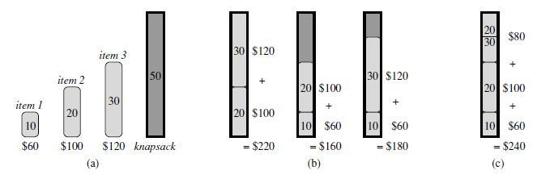
Difference between 0-1 and fractional Knapsack

Slide 24
Solution to the Fractional Knapsack Problem
In this version of a problem the items can be broken into smaller piece, so the thief may decide to carry only a fraction x_{i} of object i, where 0 ≤ x_{i} ≤ 1.
Item i contributes x_{i}w_{i} to the total weight in the knapsack, and x_{i}v_{i} to the value of the load.
In Symbol, the fraction knapsack problem can be stated as follows.
maximize ^{n}S_{i=1} x_{i}v_{i} subject to constraint ^{n}S_{i=1} x_{i}w_{i} ≤ W
It is clear that an optimal solution must fill the knapsack exactly,. Thus in an optimal solution
^{n}S_{i=1} x_{i}w_{i} = W.

Slide 25
Greedy-fractional-knapsack (w, v, W)
FOR i =1 to n
do x[i] =0
weight = 0
while weight < W
do i = best remaining item
IF weight + w[i] ≤ W
then x[i] = 1
weight = weight + w[i]
else
x[i] = (w - weight) / w[i]
weight = W
return x

Slide 26
Huffman codes
Huffman codes are a widely used and very effective technique for compressing data.
We consider the data to be a sequence of characters.
Huffman’s greedy algorithm uses a table of the frequencies of occurrence of the characters to build up an optimal way of representing each character as a binary string.

Slide 27
Suppose we have a 100,000-character data file that we wish to store compactly.
We observe that the characters in the file occur with the frequencies given by following figure 1(next page).
That is, only six different characters appear, and the character a occurs 45,000 times.

Slide 28
 | a | b | c | d | e | f
Frequency (in thousands) | 45 | 13 | 12 | 16 | 9 | 5
Fixed-length codeword | 000 | 001 | 010 | 011 | 100 | 101
Variable-length codeword | 0 | 101 | 100 | 111 | 1101 | 1100
Figure 1

Slide 29
There are many ways to represent such a file of information.
We consider the problem of designing a binary character code (or code for short) wherein each character is represented by a unique binary string.
If we use a fixed-length code, we need 3 bits to represent six characters: a = 000, b = 001, . . . , f = 101.
This method requires 300,000 bits to code the entire file.
Can we do better?
A variable-length code can do considerably better than a fixed-length code, by giving frequent characters short codewords and infrequent characters long codewords.
Above figure 1 shows such a code; here the 1-bit string 0 represents a, and the
4-bit string 1100 represents f. This code requires
(45 · 1 + 13 · 3 + 12 · 3 + 16 · 3 + 9 · 4 + 5 · 4) · 1,000 = 224,000 bits
to represent the file, a savings of approximately 25%. In fact, this is an optimal character code for this file.

Slide 30
Prefix codes
We consider here only codes in which no codeword is also a prefix of some other codeword. Such codes are called prefix codes.
Encoding is always simple for any binary character code; we just concatenate the codewords representing each character of the file. For example, with the variable length
prefix code of Figure 1, we code the 3-character file abc as 0·101·100 = 0101100, where we use “·” to denote concatenation.

Slide 31
Prefix codes
Prefix codes are desirable because they simplify decoding.
Since no codeword is a prefix of any other, the codeword that begins an encoded file is unambiguous.
We can simply identify the initial codeword, translate it back to the original character,
and repeat the decoding process on the remainder of the encoded file.
In our example, the string 001011101 parses uniquely as 0 · 0 · 101 · 1101, which decodes to aabe.

Slide 32
Prefix codes
The decoding process needs a convenient representation for the prefix code so that the initial codeword can be easily picked off.
A binary tree whose leaves are the given characters provides one such representation.
We interpret the binary codeword for a character as the path from the root to that character, where 0 means “go to the left child” and 1 means “go to the right child.”
Figure on next slide shows the trees for the two codes of our example. Note that these are not binary search trees,
since the leaves need not appear in sorted order and internal nodes do not contain character keys.

Slide 33
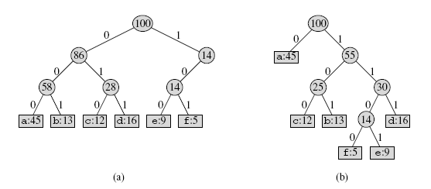
Prefix codes

Slide 34
Prefix codes
An optimal code for a file is always represented by a full binary tree, in which every nonleaf node has two children .
The fixed-length code in our example is not optimal since its tree, shown in Figure 2(a), is not a full binary tree

Slide 35
Constructing a Huffman code
Huffman invented a greedy algorithm that constructs an optimal prefix code called a Huffman code.
In the following algorithm, we assume that C is a set of n characters and that each character c ∈ C is an object with a defined frequency f [c].
The algorithm builds the tree T corresponding to the optimal code in a bottom-up manner.
It begins with a set of |C| leaves and performs a sequence of |C| − 1 “merging” operations to create the final tree.
A min-priority queue Q, keyed on f , is used to identify the two least-frequent objects to merge together.
The result of the merger of two objects is a new object whose frequency is the sum of the frequencies of the two objects that were merged.

Slide 36
Constructing a Huffman code
HUFFMAN(C)
1 n ← |C|
2 Q ← C
3 for i ← 1 to n − 1
4 do allocate a new node z
5 left[z]← x ← EXTRACT-MIN(Q)
6 right[z]← y ← EXTRACT-MIN(Q)
7 f [z]← f [x] + f [y]
8 INSERT(Q, z)
9 return EXTRACT-MIN(Q) (Return the root of the tree.)

Slide 37
Constructing a Huffman code
Analysis of the running time of Huffman’s algorithm
It assumes that Q is implemented as a binary min-heap. For a set C of n characters,
The initialization of Q in line 2 can be performed in O(n) time using the BUILD-MINHEAP procedure.
The for loop in lines 3–8 is executed exactly n−1 times, and since each heap operation requires time O(lg n), the loop contributes O(n lg n) to the running time.
Thus, the total running time of HUFFMAN on a set of n characters is O(n lg n).

Slide 38
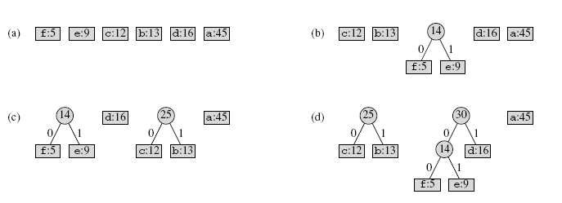
Constructing a Huffman code

Slide 39
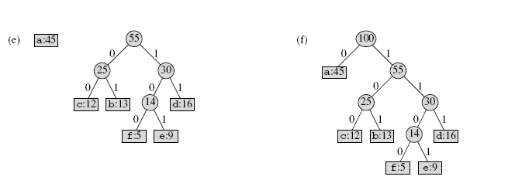
Constructing a Huffman code

Slide 40
A task-scheduling problem
This is the problem of optimally scheduling unit-time tasks on a single processor, where each task has a deadline, along with a penalty that must be paid if the deadline is missed.
A unit-time task is a job, such as a program to be run on a computer, that requires exactly one unit of time to complete. Given a finite set S of unit-time tasks,
A schedule for S is a permutation of S specifying the order in which these tasks are to be performed.
The first task in the schedule begins at time 0 and finishes at time 1, the second task begins at time 1 and finishes at time 2, and so on.

Slide 41
A task-scheduling problem
The problem of scheduling unit-time tasks with deadlines and penalties for a single processor has the following inputs:
• a set S = {a1, a2, . . . , an} of n unit-time tasks;
• a set of n integer deadlines d1, d2, . . . , dn, such that each di satisfies 1 ≤ di ≤ n and task ai is supposed to finish by time di; and
• a set of n nonnegative weights or penalties w1,w2, . . . , wn, such that we incur a penalty of wi if task ai is not finished by time di and we incur no penalty if a task finishes by its deadline.
We are asked to find a schedule for S that minimizes the total penalty incurred for missed deadlines.

Slide 42
A task-scheduling problem
Algorithm:
1. Arrange all jobs in decreasing order of penalties in array J.
Take an array A of size of maximum deadline.
Start from right end of the array A, search for the job which contain deadline ≥ di in array J. For every slot i.

Slide 43
A task-scheduling problem
Algorithm:
1. Array all jobs in decreasing order of penalties in array J (use merge sort (O(nlgn) time)).
Take an array A of size of maximum deadline.
Start from right end of the array A, search for the job which contain deadline ≥ di in array J. For every slot i (using linear search (O(n2)) ).
Total time O(nlgn+n²)=O(n²)

Slide 44
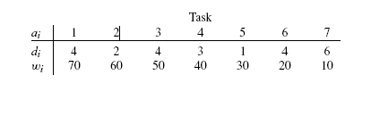
A task-scheduling problem: Example

